Slide 1

Supply chain
management of retail
store

Slide 2

Abstract
In this presentation, we will explore how leveraging data from a supply chain database can optimize operations and drive efficiency in supply chain management. We'll delve into the structure of the database, analyze key tables and relationships, and demonstrate the power of SQL queries in extracting valuable insights for decision-making.

Slide 3
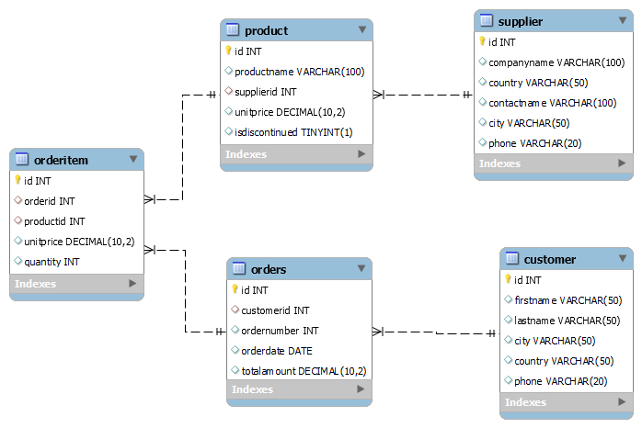
ER-DIAGRAM

Slide 4
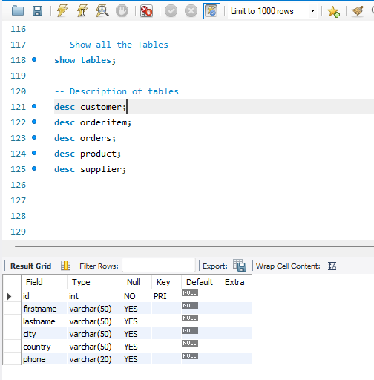
STRUCTURE OF TABLE
Customer table:
This table stores information about customers, including their unique identifier (id), first name, last name, city, country, and phone number.
Syntax: DESC customer:

Slide 5
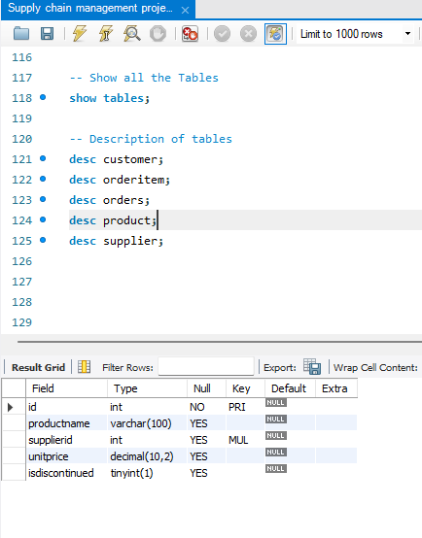
STRUCTURE OF TABLE
Product table:
This table stores information about products available in the supply chain. It includes a product ID, name, supplier ID (linked to the Supplier table), unit price, and a flag indicating whether the product is discontinued.
Syntax: DESC product;

Slide 6
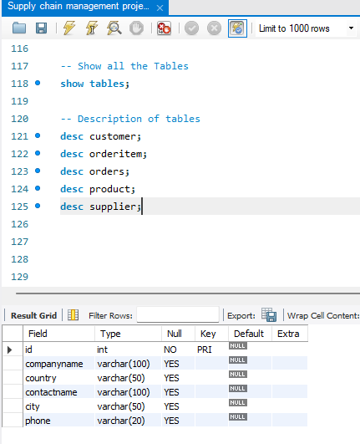
STRUCTURE OF TABLE
Supplier table:
This table contains details about suppliers, such as their unique identifier (id), company name, country, contact name, city, and phone number.
Syntax: DESC supplier;

Slide 7
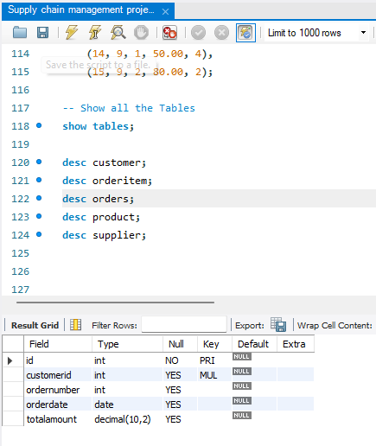
STRUCTURE OF TABLE
Orders table:
Here, each record represents an order placed by a customer. It includes an order ID, customer ID (linked to the Customer table), order number, order date, and total amount.
Syntax: DESC Orders;

Slide 8
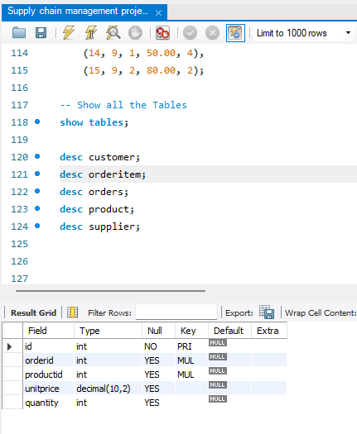
STRUCTURE OF TABLE
Orderitem table:
The Orderitem table represents individual items within each order. It includes an item ID, order ID (linked to the Orders table), product ID (linked to the Product table), unit price, and quantity ordered.
Syntax: DESC orderitem;

Slide 9
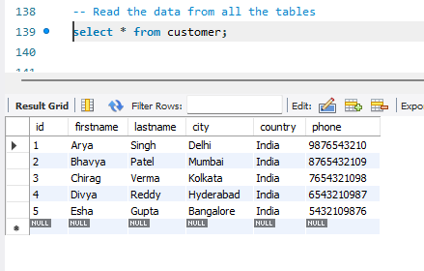
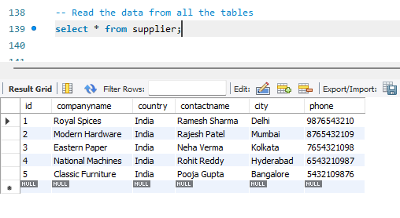
CONTENT OF TABLE
Customer table
Supplier table

Slide 10
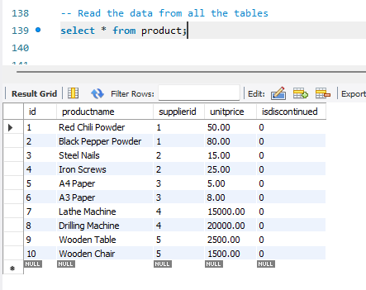
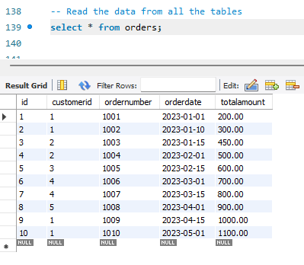
CONTENT OF TABLE
Product table
Orders table

Slide 11
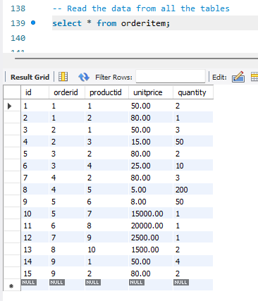
CONTENT OF TABLE
Orderitem table

Slide 12

SUB QUERIES
Let’s dive in

Slide 13
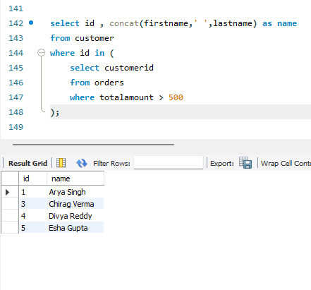
SUBQUERY
1. Find the names of customers who have placed orders worth more than 500 rupees.
Syntax:
select id , concat(firstname,' ',lastname) as name from customer where id in (select customerid from orders where totalamount > 500);

Slide 14
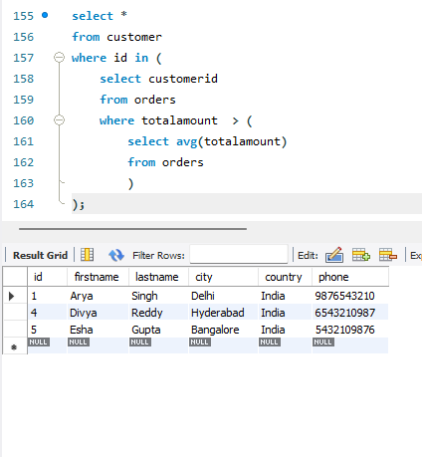
SUBQUERY
2. Find customers who have placed orders with a total amount greater than the average order amount.
Syntax:
select * from customer where id in (select customerid from orders where totalamount > (select avg(totalamount) from orders));

Slide 15
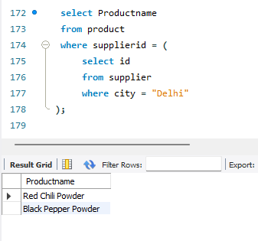
SUBQUERY
3.List products that are supplied by companies based in Delhi.
Syntax:
select Productname from product where supplierid = (select id from supplier where city = "Delhi");

Slide 16
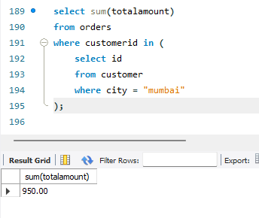
SUBQUERY
4. Find the total amount spent by customers in Mumbai.
Syntax:
select sum(totalamount) from orders where customerid in (select id from customer where city = "mumbai");

Slide 17
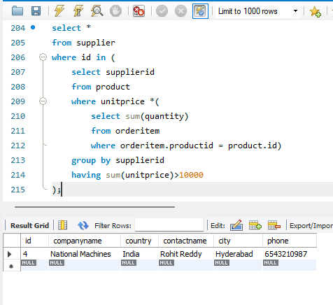
SUBQUERY
5.Find the supplier names who supply products worth more than 10000 rupees.
Syntax:
select * from supplier where id in (select supplierid from product where unitprice *select sum(quantity) from orderitem where orderitem.productid = product.id) group by supplierid having sum(unitprice)>10000);

Slide 18
JOINS
Let’s dive in

Slide 19
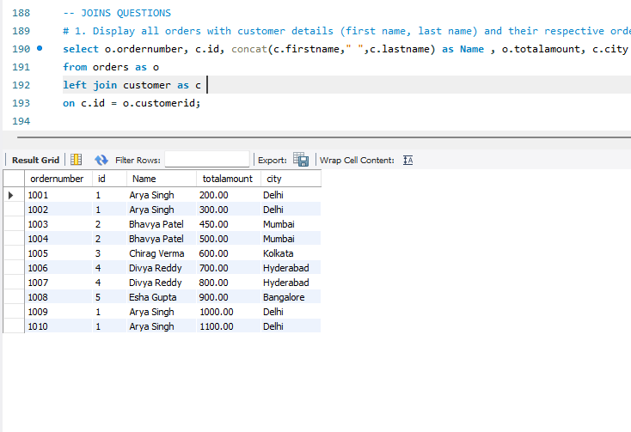
JOINS
1. Display all orders with customer details (first name, last name) and their respective order numbers.
Syntax:
select o.ordernumber, c.id, concat(c.firstname," ",c.lastname) as Name , o.totalamount, c.city from orders as o left join customer as c on c.id = o.customerid;

Slide 20
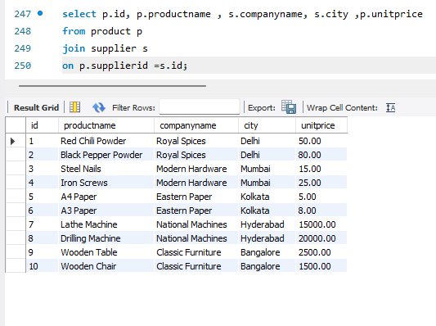
JOINS
2. List all products along with their suppliers' company names ,cities and unit price of product.
Syntax:
select p.id, p.productname , s.companyname, s.city ,p.unitpricefrom product p join supplier s on p.supplierid =s.id;

Slide 21
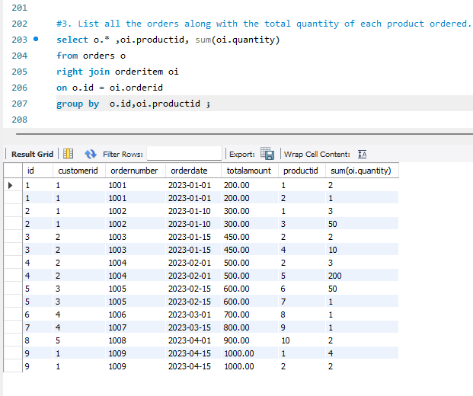
JOINS
3. List all the orders along with the total quantity of each product ordered.
Syntax:
select o.* ,oi.productid, sum(oi.quantity) from orders o right join orderitem oi on o.id = oi.orderid group by o.id,oi.productid ;

Slide 22
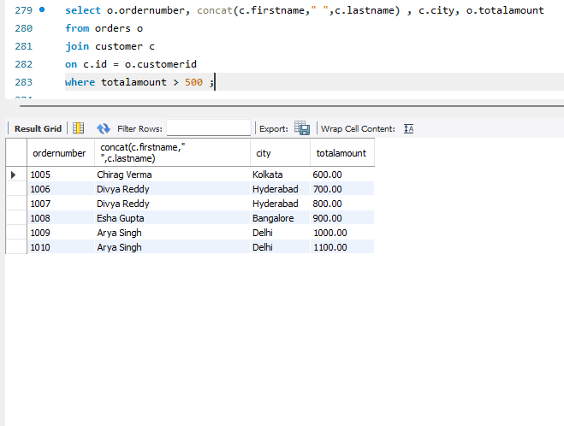
JOINS
4. Display orders along with customer names and their cities where the order total amount is greater than 500.
Syntax:
select o.ordernumber, concat(c.firstname," ",c.lastname) , c.city, o.totalamount from orders o join customer c on c.id = o.customerid where totalamount > 500 ;

Slide 23
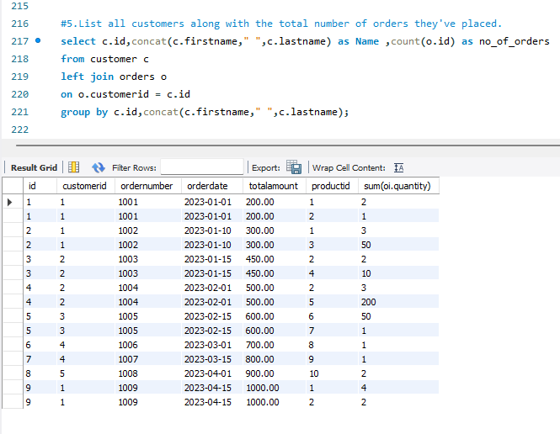
JOINS
5. List all customers along with the total number of orders they've placed.
Syntax:
select c.id,concat(c.firstname," ",c.lastname) as Name ,count(o.id) as no_of_ordersfrom customer c left join orders o on o.customerid = c.id group by c.id,concat(c.firstname," ",c.lastname);

Slide 24
MULTIPLE JOINS
Let’s dive in

Slide 25
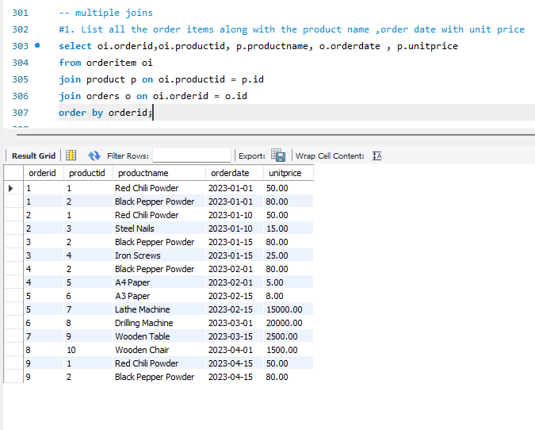
MULTIPLE JOINS
1. List all the order items along with the product name ,order date with unit price
Syntax:
select oi.orderid,oi.productid, p.productname, o.orderdate , p.unitpricefrom orderitem oijoin product p on oi.productid = p.id join orders o on oi.orderid = o.idorder by orderid;

Slide 26
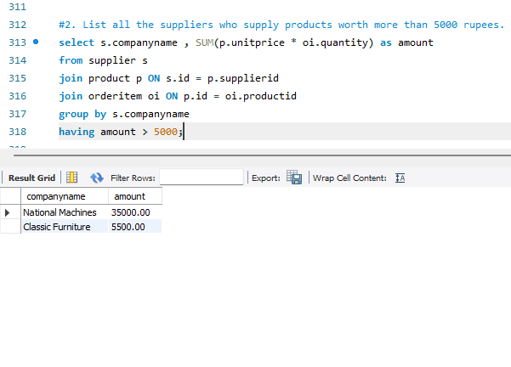
MULTIPLE JOINS
2. List all the suppliers who supply products worth more than 5000 rupees.
Syntax:
select s.companyname , SUM(p.unitprice * oi.quantity) as amountfrom supplier sjoin product p ON s.id = p.supplierid join orderitem oi ON p.id = oi.productid group by s.companyname having amount > 5000;

Slide 27
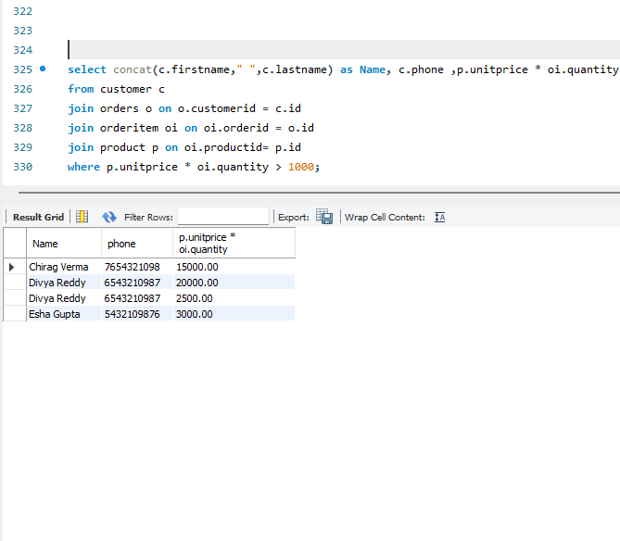
MULTIPLE JOINS
3.Find the names and contact information of all customers who have ordered products worth more than 1000 rupees in total.
Syntax:
select concat(c.firstname," ",c.lastname) as Name, c.phone ,p.unitprice * oi.quantityfrom customer c join orders o on o.customerid = c.idjoin orderitem oi on oi.orderid = o.idjoin product p on oi.productid= p.idwhere p.unitprice * oi.quantity > 1000;

Slide 28

Thank you
Nikhil Gulvi
IT Vedant
Nov23- T313/DS/PS/11-1pm

